Slide 1
Centralized Reporting Infrastructure and Disclosure Informativeness: Evidence from Germany
Stephan Kaiser | Paderborn University
Reeyarn Z. Li | Paderborn University Sönke Sievers | Paderborn University
29 May 2025
Notes:
Good afternoon, everyone.
I would like to thank you all for coming to this session.
My name is Reeyarn Li. I’m a post doc from Paderborn University in Germany.
Today, I'll present our research paper titled: 'Centralized Reporting Infrastructure and Disclosure Informativeness: Evidence from Germany.’
It is co-authored with my great friend Stephan Kaiser, and my advisor Sönke Sievers, both also from Paderborn.

Slide 2
In a nutshell
We study the disclosure informativeness of German annual reports under a centralized reporting platform.
To offer crucial insights for the on-going reform toward an integrated European Single Access Point (ESAP).
Why
How
What
Applying BERT: a language embedding model
Using a novel measure of disclosure informativeness that captures the semantic changes in annual reports.
Findings:
Disappeared after ESEF
Disclosure
Informativeness
Associated with
Information Asymmetry
Earnings Quality
Notes:
Let me start with a brief overview.
We study the disclosure informativeness of German annual reports under a centralized reporting platform, where all firms submit their reports to one national authority just like the EDGAR in the US.
Why? Our goal is to offer insights for the EU regulators regarding the on-going reform of capital market integration.
How do we do that?
We build a novel measure of disclosure informativeness.
This model applies BERT, a language embedding model and captures semantic changes in annual reports, measuring the new contents in the reports.
Our key findings show that disclosure informativeness is associated with information asymmetry and earnings quality.
However, these effects disappear after companies adopted the EU’s ESEF reporting format in 2020.

Slide 3
Background
motivation
Why do we study disclosure informativeness in Germany?
The on-going integration “Capital Markets Union” toward the ESAP (European Single Access Point) has seen a major set back.
Initial target: fully operational by Dec 31, 2024
Now delayed to July 1, 2027.
Reasons for delay:
Technical complexity, testing time needed, etc.
Push back by companies
Our setting: ESMA’s ESEF (European Single Electronic Format) requires corporate financial reports in XHTML format with XBRL tags after 2020.
Motivating questions: How does EU’s new disclosure requirement affect disclosure informativeness? What are the impacts on the information environment in the capital market?
Existing studies suggest these reforms increase proprietary cost (Breuer et al., 2022; Breuer and Breuer, 2023)
Notes:
So, why do we study disclosure informativeness in Germany?
Is it just a German paper? No. That's what we want to position the paper, as an EU paper.
The EU is working towards the Capital Markets Union, with
the European Single Access Point (ESAP), where all firms from the whole EU, fill their financial reports to one EU regulator, instead of to the national authorities. This is great idea! I can't wait for it.
However, ESAP's full operation has been delayed. It's now targeted for July 2027, instead of late 2024.
What caused the delay? Yeah, Technical complexity of course, but also so some pushback from companies. But due to the on-going nature, we do not have data and must wait.
For us, our research setting is ESMA’s ESEF mandate, which became effective in 2020.
Since 2020, The regulator ESMA requires corporate financial reports in XHTML format with XBRL tags, namely ESEF.
The intended goal is to increase standardization and comparability.
But how does it work **in reality**?
How does this new EU disclosure requirement affect disclosure informativeness? And what are the impacts on the information environment in the capital market?
Is this regulation good? Or is it bad? How bad is it? Can we see through the data?
==
Reasons for delay: technical complexity; Need for tech standard; Time for testing;
Push back by companies: there must be no additional disclosure requirement; such as multi-lingual.
Companies have big doubts regarding the ESEF.
Different from IFRS effects.
Where to download; monitorning
Format; content; We need to see in eyes that the content really changed. Dyer style.

Slide 4
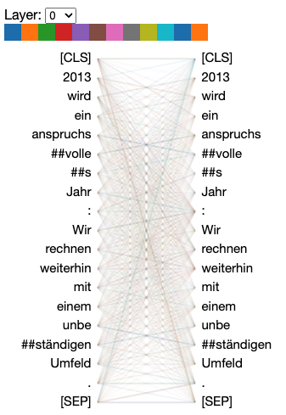
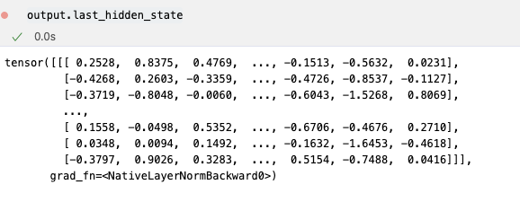
Measure of informativeness
With a Language embedding model: BERT
BERT encodes sentences into an embedding vector of float numbers that capture the semantic meaning
We measure informativeness as the # words that are new:
We also use BERT to decompose reports into topics.
Data: German annual reports downloaded from German Company Registry between 2007 – 2024 (N=5,105); Compustat Global.
2013 wird ein anspruchsvolles Jahr: Wir rechnen weiterhin mit einem unbeständigen Umfeld. （ BASF 2013）
Informativeness = $\#Words ⋅\sin\left(emb_{t}, emb_{t−1}\right)$
Notes:
How do we measure informativeness? We use a language model called BERT. BERT was designed by Google in 2018. Similar to the Chat GPT, and all the LLMs, It encodes sentences into a long vector of numbers. These vectors capture semantic meaning.
Our specific measure of informativeness is the length of new contents (measured in the number of words) in in an annual report, compared to the previous year's report.
Our data consists of over 5,000 German annual reports. These span from 2007 to 2024. We also use Compustat Global data.

Slide 5
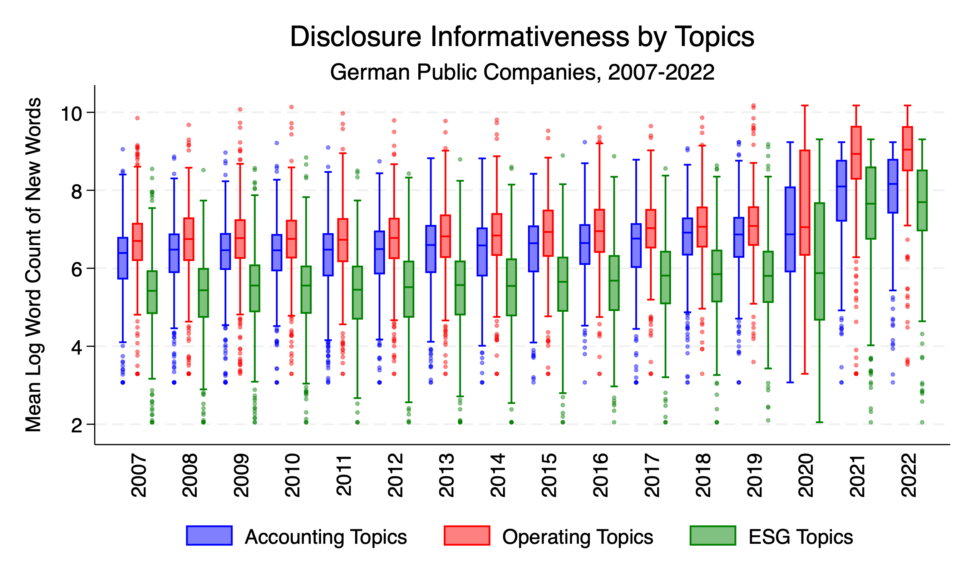
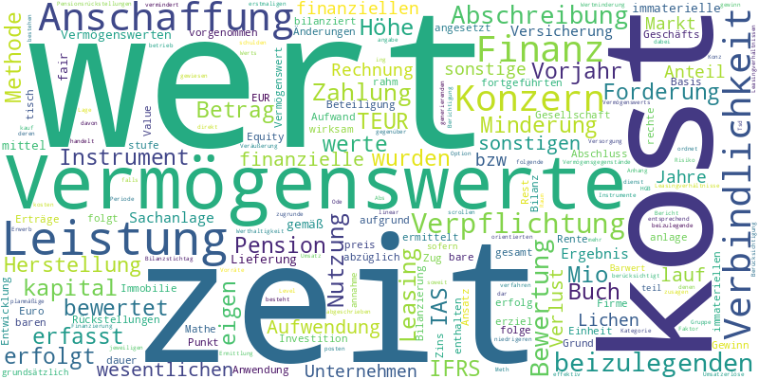
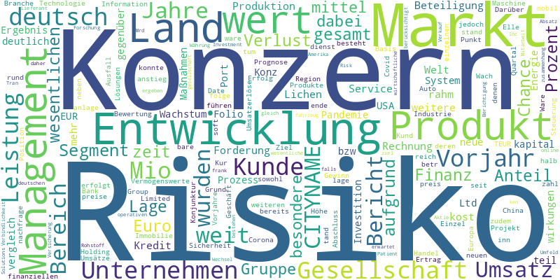
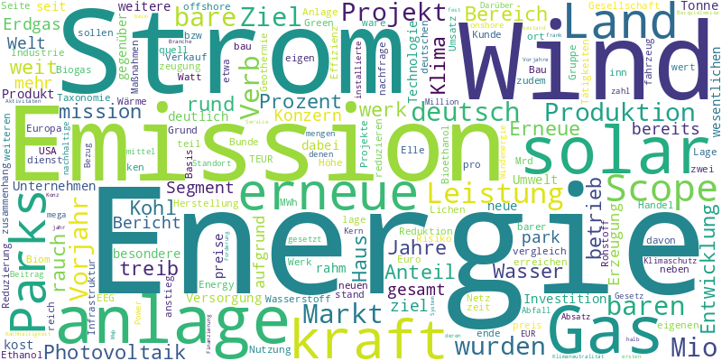
Decomposing reports with BERTopic
Accounting Operating ESG
Notes:
We decompose these reports into three topic groups, namely,
Accounting, Operating, and ESG disclosures.
How does our main variable of interest look like?
The amount of new contents in the report.

Slide 6
Hypotheses
Disclosure
Informativeness
Earnings Quality
H1: A higher disclosure Informativeness is associated with a smaller magnitude of absolute abnormal accruals.
H2: A higher disclosure Informativeness is associated with a smaller magnitude of Amihud Illiquidity.
H3: The association between disclosure Informativeness and earnings quality/information asymmetry disappear after firms adopting ESEF.
Information Asymmetry
Notes:
Empirically, we investigate the following three hypotheses:
First (H1): Higher disclosure informativeness is associated with smaller absolute abnormal accruals. This indicates better earnings quality.
Second (H2): Higher disclosure informativeness is associated with smaller Amihud Illiquidity. This suggests lower information asymmetry.
Third (H3): We predict that these beneficial associations will disappear after firms adopt ESEF.

Slide 7
Testing H1: A higher disclosure Informativeness is associated with a smaller magnitude of absolute abnormal accruals.
Decomposing informativeness by topics:
Accounting
Operating
ESG
Size-matched accruals (Ecker et al. 2013)
Controlling for accrual determinants (Owens et al. 2017)
S.E. clustered by firm and year.
Notes:
Let's turn to our results.
For H1, we test the link between informativeness and earnings quality. As you can see in the table [gesture to the first table], we find a significant negative association.
Higher informativeness is indeed linked to smaller absolute abnormal accruals. This finding holds when we decompose informativeness by topic: Accounting,
Operating, and ESG disclosures show similar patterns.

Slide 8
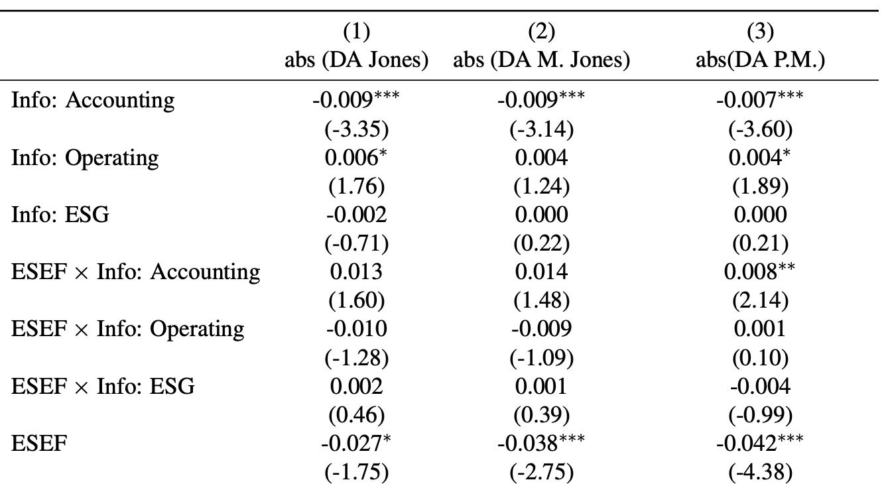
Testing H3: The association between disclosure Informativeness and earnings quality/information asymmetry disappear after firms adopting ESEF.
Notes:
Now, let's consider H3 regarding the impact of ESEF on earnings quality. The table shows our test of this hypothesis.
We find that the beneficial association between informativeness and earnings quality significantly weakens after firms adopt ESEF. The interaction term [point to it if relevant] confirms this change.
Note that it is based on full sample.
For High IO, post-ESEF effects would persist. For Low-IO, post-ESEF disappear.

Slide 9
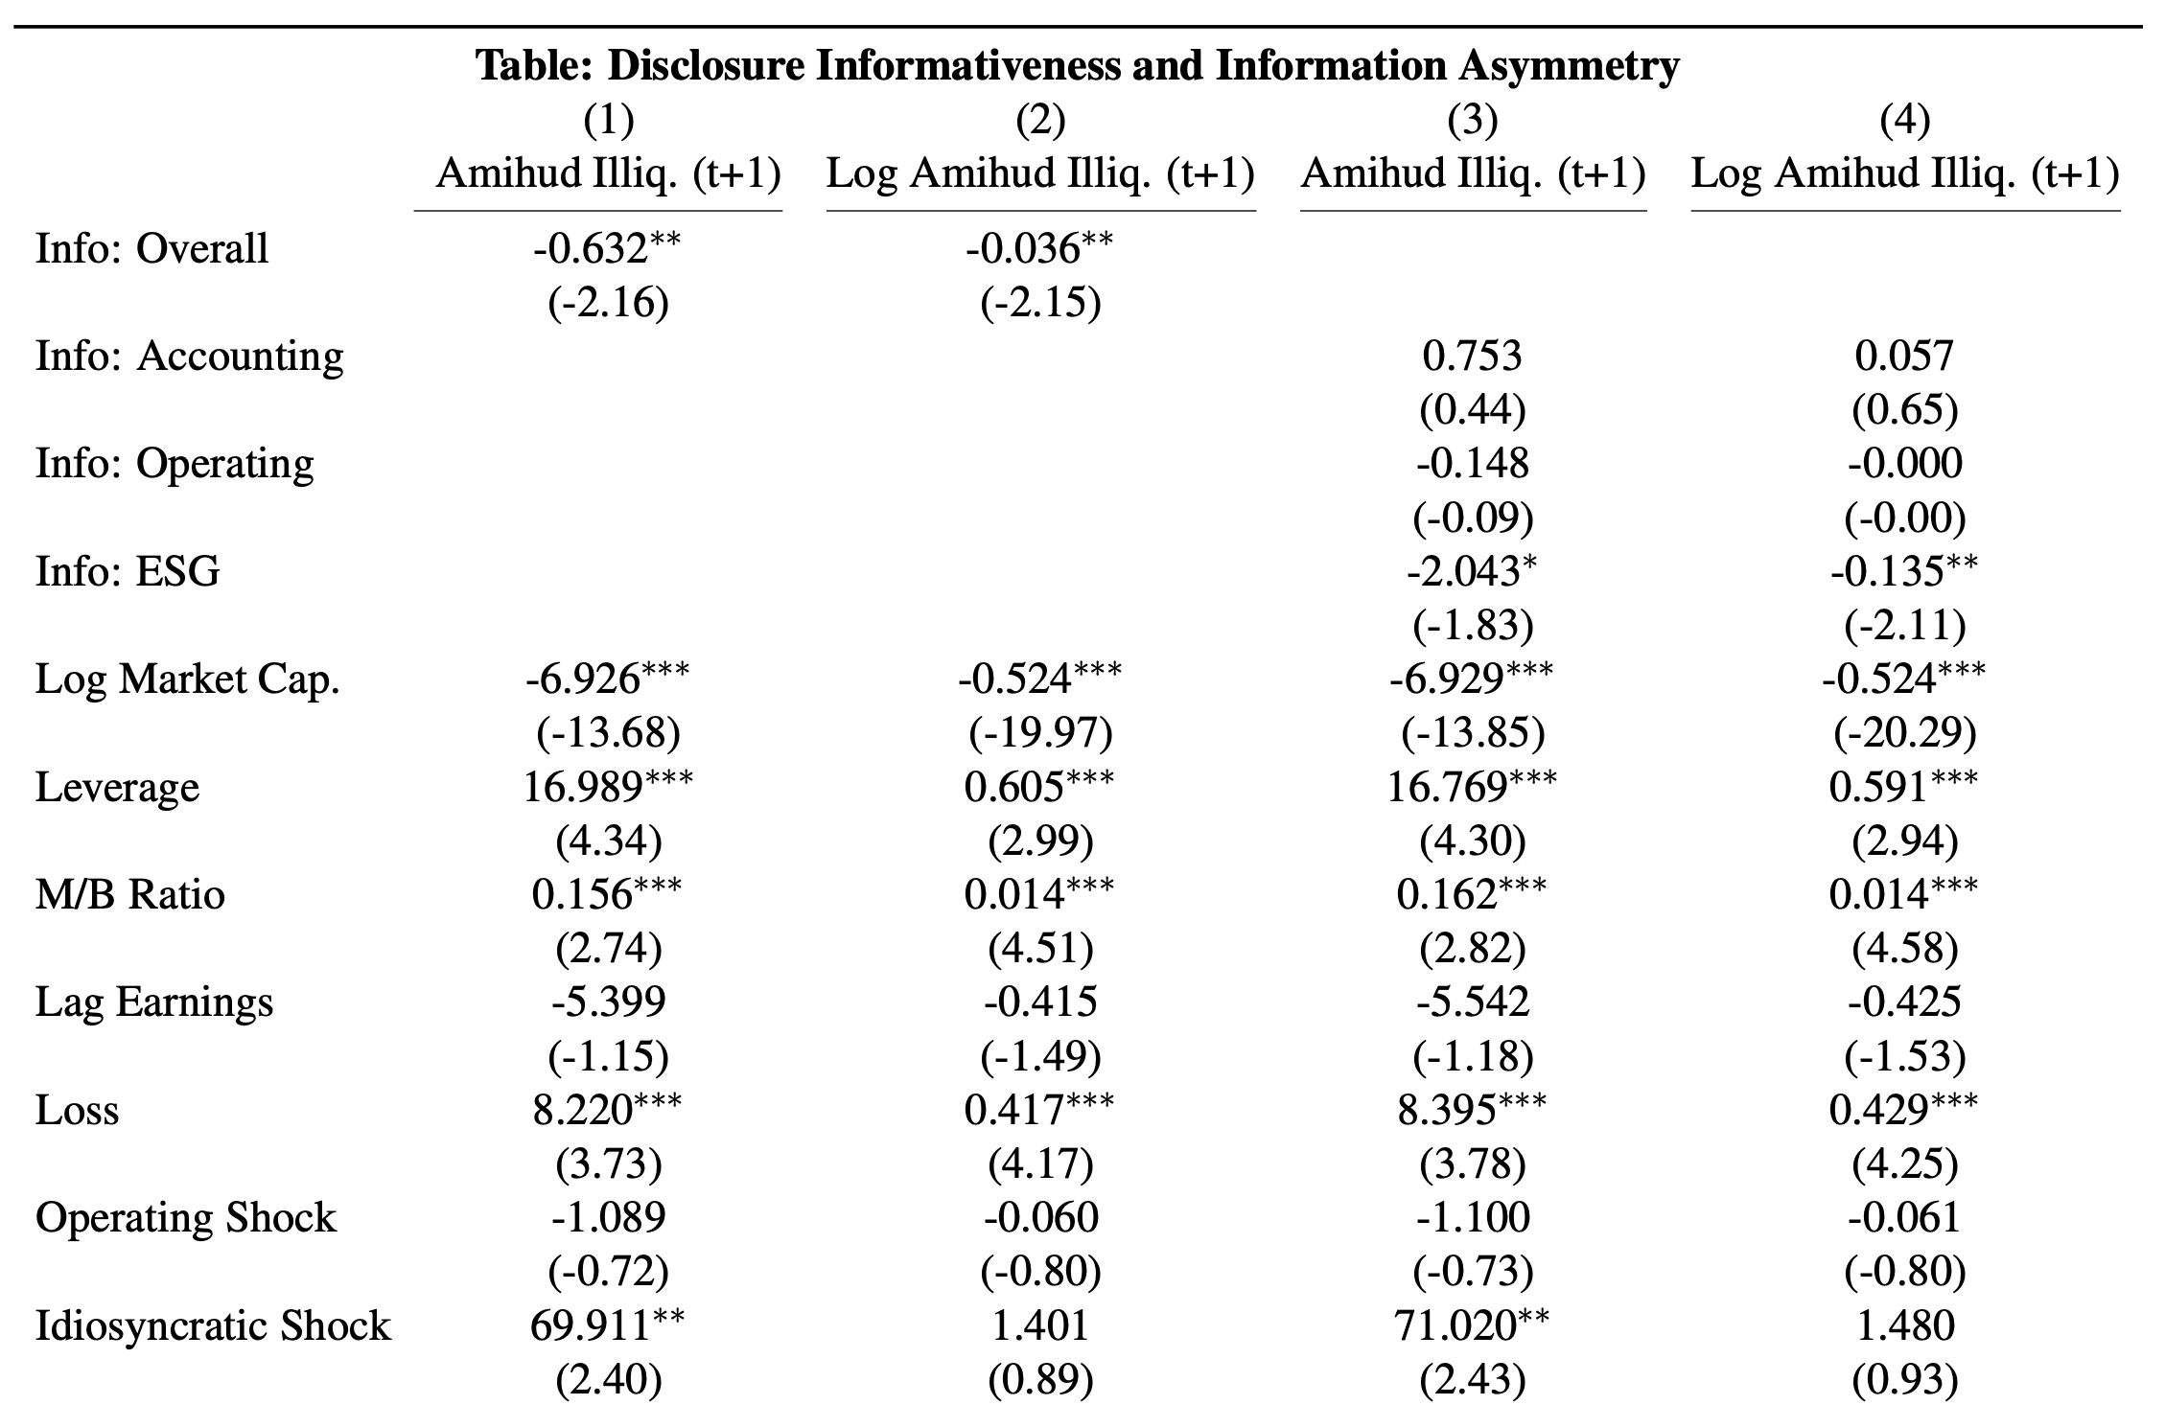
Testing H2: A higher disclosure Informativeness is associated with a smaller magnitude of Amihud Illiquidity.
Notes:
Next, we test H2, focusing on information asymmetry. The results [gesture to table, assuming it shows Amihud results] support this hypothesis. Higher disclosure informativeness is significantly associated with lower Amihud Illiquidity. This suggests that more informative reports reduce information asymmetry in the market.

Slide 10
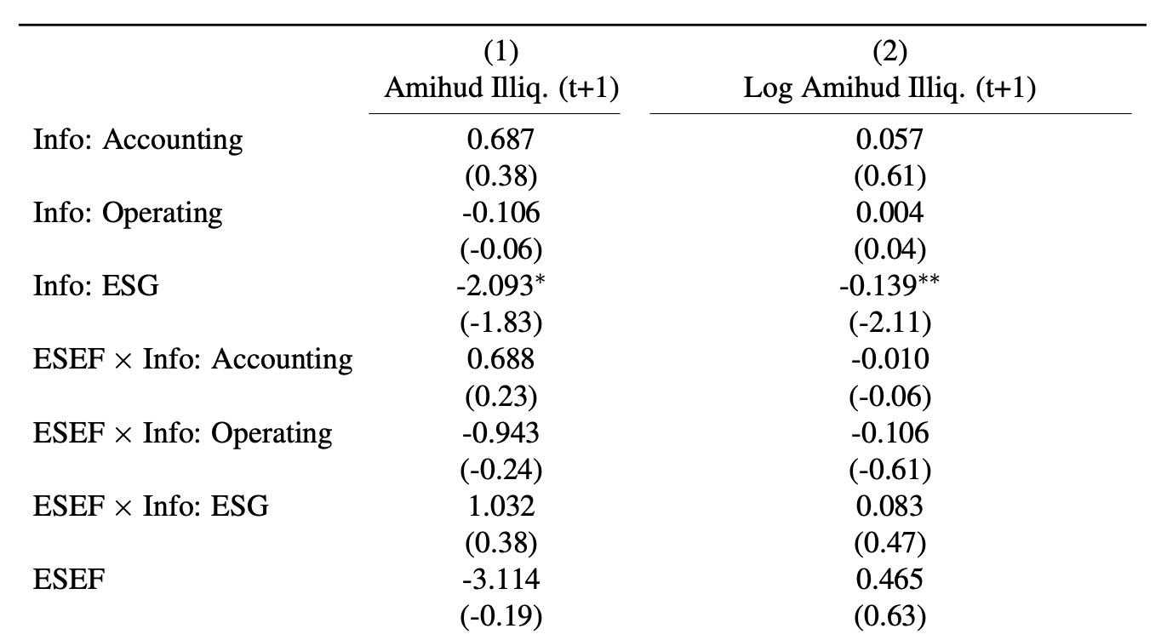
Testing H3: The association between disclosure Informativeness and earnings quality/information asymmetry disappear after firms adopting ESEF.
Notes:
Finally, we test H3 again, this time for information asymmetry post-ESEF. Similar to our earnings quality findings, the results are striking. The table [gesture to table] and graph show that the beneficial link between informativeness and lower information asymmetry also diminishes after ESEF adoption. The positive impact of informativeness is significantly reduced in the post-ESEF period.

Slide 11
Contributions and Conclusions
Novel Methodology: Introducing a novel, semantically-driven measure of disclosure informativeness, leveraging BERTopic analysis of textual annual reports.
Key Findings:
Higher disclosure informativeness significantly reduced information asymmetry (lower Amihud illiquidity) and improved earnings quality (lower abnormal accruals).
Crucially, these beneficial associations disappeared after the adoption of the European Single Electronic Format (ESEF) in 2020.
Core Conclusion: Centralized digital reporting, while enhancing accessibility, may unintentionally foster more standardized, less incrementally informative disclosures.
Policy Implications: Offering critical insights for the design and implementation of the ESAP, highlighting a potential trade-off between standardization and the richness of disclosure.
Notes:
So, what are our main contributions and conclusions? First, we introduce a novel, semantically-driven measure of disclosure informativeness. This leverages BERTopic analysis. Our key findings show that higher disclosure informativeness was associated with reduced information asymmetry and improved earnings quality. Crucially, these beneficial associations largely disappeared after the adoption of ESEF in 2020. Our core conclusion is this: Centralized digital reporting, like ESEF, enhances accessibility. However, it may unintentionally foster more standardized, and thus less incrementally informative, disclosures. This has important policy implications. It offers critical insights for the design of ESAP, highlighting a potential trade-off between standardization and the richness of corporate disclosure.

Slide 12
Thank you for your attention!
Notes:
Thank you very much for your attention. I am now happy to take any questions you may have.

